Slide 1
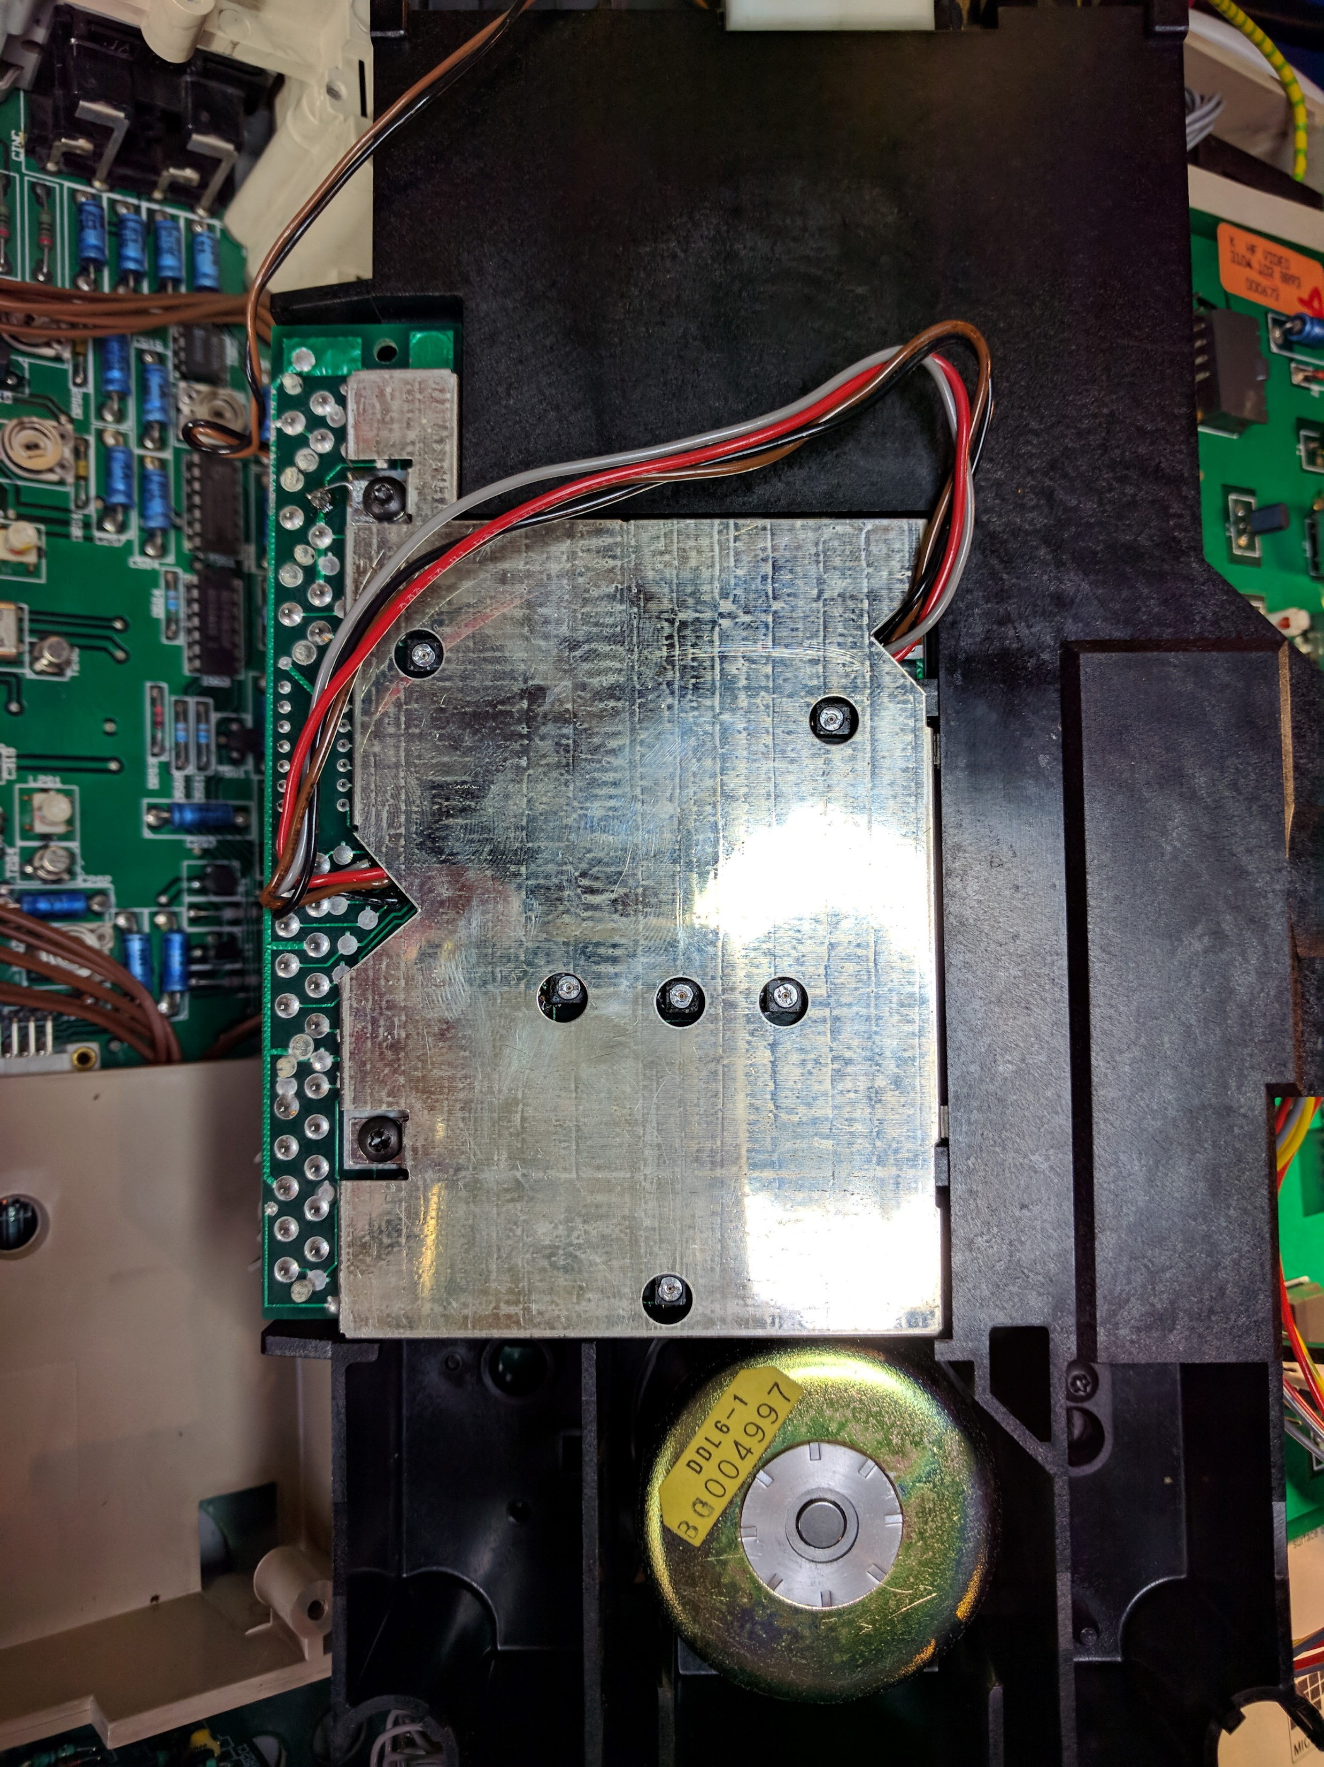
3058
Foc/Rad Ratio
3040
HF Amplitude
3079
Radial Gain
3076
Radial
Balance
3066
Focus
Gain
3088
Tilt Offset

